Slide 1
AI & ML Tools, Libraries, Software

Slide 2

Machine Learning
Machine learning is a powerful field of artificial intelligence that enables computers to learn and improve from data without being explicitly programmed. It has revolutionized many industries, from healthcare to finance, by uncovering insights and automating complex tasks.

Slide 3
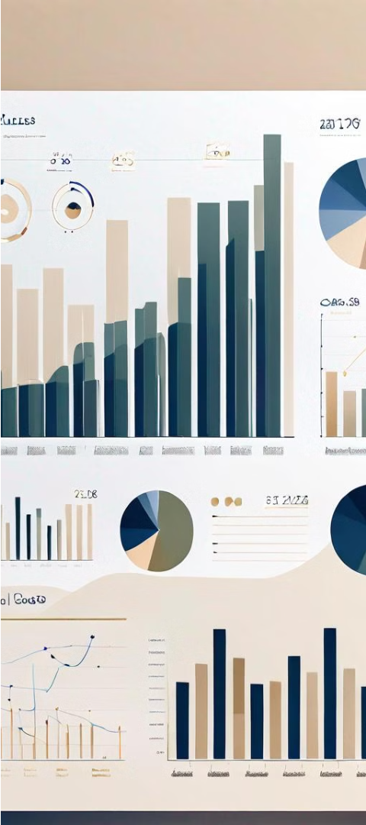
Prediction Problems in Machine Learning
1
Regression
2
Time Series Forecasting
Predicting a continuous numerical output, such as sales figures or housing prices, based on input variables.
Predicting future values in a sequence of data, like stock prices or weather patterns, using historical trends.
3
Anomaly Detection
Identifying rare or unusual data points that deviate significantly from the norm, such as credit card fraud or system failures.

Slide 4



Classification Problems in Machine Learning
Supervised Learning
Model Training
Evaluation Metrics
Classification is a type of supervised learning where the goal is to predict a categorical output variable based on input features.
The model is trained on labeled data to learn the underlying patterns and relationships between the inputs and outputs.
Classification models are typically evaluated on metrics like accuracy, precision, recall, and F1-score to measure their performance.

Slide 5
Clustering Problems in Machine Learning
Grouping Similar Data
Unsupervised Learning
Clustering algorithms identify patterns and group similar data points together, without prior knowledge of the groups. This is useful for market segmentation, anomaly detection, and exploratory data analysis.
Clustering is an unsupervised learning technique, meaning the algorithm discovers the inherent structure of the data on its own, without the need for labeled examples.
Common Algorithms
Applications
K-Means, Hierarchical Clustering, DBSCAN, and Gaussian Mixture Models are popular clustering algorithms used to solve a variety of real-world problems.
Clustering has diverse applications in fields like customer segmentation, recommendation systems, image segmentation, and bioinformatics, where grouping similar data points is crucial.

Slide 6



Artificial Intelligence & Machine Learning Tools
AI/ML Software
Development Tools
Monitoring & Evaluation
A wide range of specialized software tools exist for building and deploying AI and machine learning models, including TensorFlow, PyTorch, Scikit-Learn, and Azure Machine Learning.
Developers utilize integrated development environments (IDEs), cloud platforms, and other tools to design, train, and optimize machine learning models.
AI/ML tools provide dashboards and analytics capabilities to monitor model performance, detect issues, and continuously improve the system over time.

Slide 7
Popular Machine Learning Libraries
TensorFlow
Scikit-learn
PyTorch
Keras
Powerful open-source library developed by Google for building and deploying machine learning models. Supports a range of tasks including classification, regression, and natural language processing.
Comprehensive machine learning library for Python, offering a wide variety of algorithms for classification, regression, clustering, and dimensionality reduction. Known for its simplicity and ease of use.
An open-source machine learning library developed by Facebook's AI Research lab. Focuses on deep learning and is known for its flexibility and dynamic computation graphs.
High-level neural networks API, capable of running on top of TensorFlow, CNTK, or Theano. Allows for rapid experimentation with deep neural networks and supports both convolutional networks and recurrent networks.

Slide 8

Machine Learning Software and Platforms
Numerous software tools and platforms are available for machine learning, including popular options like TensorFlow, PyTorch, and Scikit-Learn. These provide powerful frameworks and libraries for building and deploying ML models across a variety of applications.
Cloud-based platforms like Amazon SageMaker, Google Cloud AI, and Microsoft Azure ML Studio offer end-to-end ML solutions with data preprocessing, model training, and deployment capabilities.

Slide 9
Applications of Machine Learning
Healthcare
Finance
Machine learning algorithms are used to analyze medical data, assist with diagnosis, and personalize treatment plans, improving patient outcomes.
ML models help banks and financial institutions detect fraud, assess credit risk, and automate investment decisions.
Automation
Marketing
Machine learning powers intelligent automation in industries like manufacturing, logistics, and customer service, boosting efficiency and productivity.
ML-driven personalization and targeted advertising enable marketers to provide more relevant and effective campaigns to consumers.

Slide 10
Challenges in Machine Learning
Data Quality
Interpretability
Computational Resources
Ethical Considerations
Ensuring high-quality, representative, and unbiased training data is crucial for building effective machine learning models. Poor data can lead to suboptimal performance and biased outputs.
Many complex machine learning models, like neural networks, can be "black boxes" where the reasoning behind their predictions is not easily explainable. Improving model interpretability is an important challenge.
Training and deploying large-scale machine learning models requires significant computational power, memory, and storage. Optimizing resource usage is an ongoing challenge.
As machine learning becomes more prevalent, the need to address ethical concerns like algorithmic bias, privacy, and accountability has grown. Developing responsible AI practices is crucial.

Slide 11



Future Trends in Machine Learning
Explainable AI
1
Improving transparency and interpretability of models
Federated Learning
2
Distributed training to protect user privacy
Quantum Computing
3
Harnessing quantum phenomena for faster ML
As machine learning continues to advance, key future trends include the development of more explainable AI models, the rise of federated learning to protect user privacy, and leveraging quantum computing to accelerate ML algorithms. These innovations promise to make AI systems more transparent, robust, and efficient.

Slide 12
Tests, Quiz

Slide 13
Thanks!

